Slide 1

Manhattan Rent Prediction by Idan, Evgenia, Chanan May 2022

Slide 2


Summary
Our project focuses on the relationship between manhattan’s rent prices and their apartment specification (floor, building age, number of rooms, bathroom, etc.)
Goal
Rent price prediction based on our Kaggle’s Manhattan apartments dataset

Slide 3
Overview
EDA with Pandas and Seaborn
Data Wrangling, convert categorical to numerical
Find features with strong correlation to target
Apply the basic Regression models of sklearn
Compare the performance of the Regressors and choose best one
Conclusions and insights

Slide 4
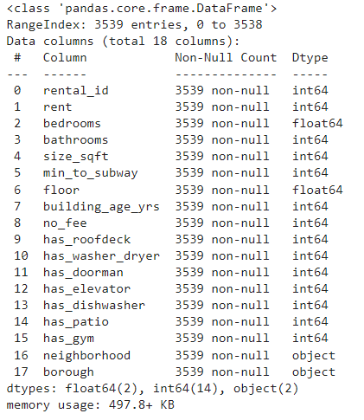
EDA 1/4
Original data set has 18 columns 3539 rows,
No missing values,
No duplicates,
32 neighborhood, which should convert to numerical

Slide 5
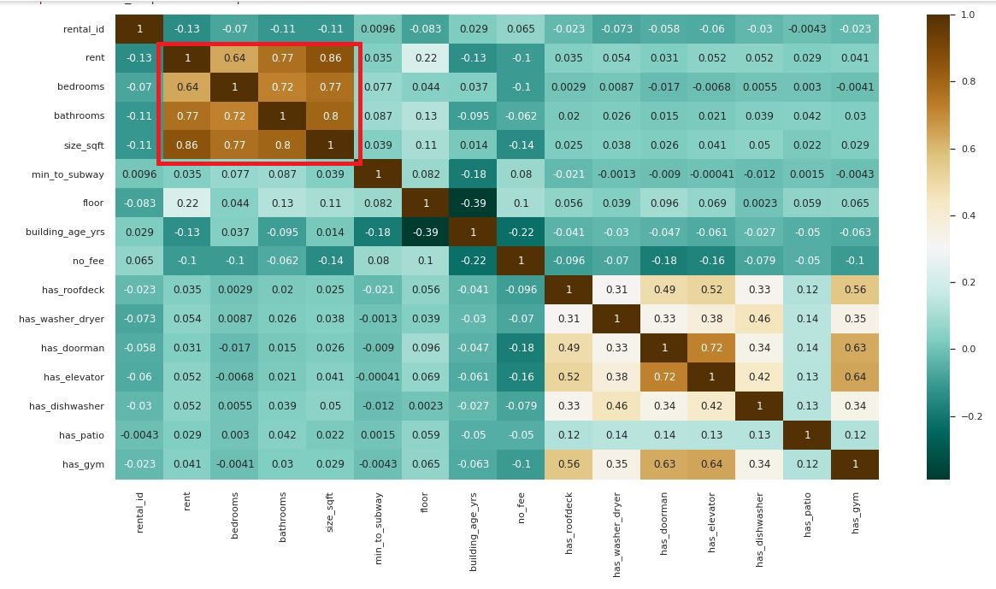
EDA 2/4
Plot Correlations shows close relationship between features: rent, bedrooms, bathrooms ,size sqft and floor.

Slide 6
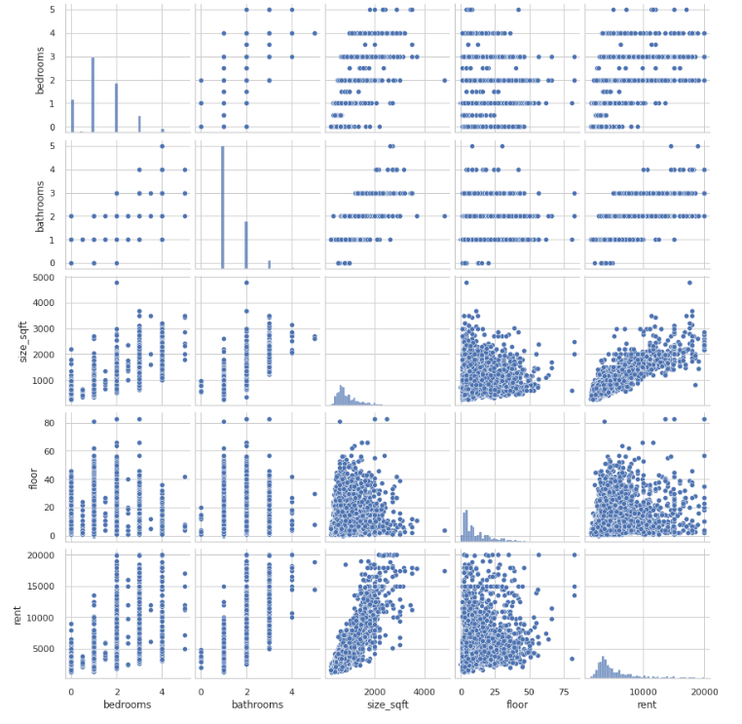
EDA 3/4
Continuing correlation we made, here is the visualization of 5 selected features using seaborn package.
Most numerical features are on a 0-1 scale

Slide 7
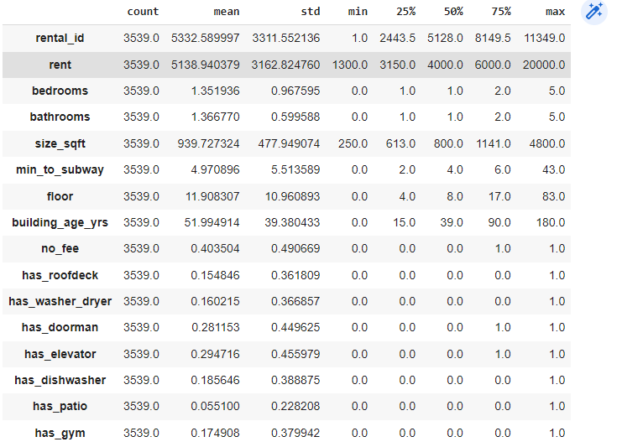
EDA 4/4
Target and Feature Distribution

Slide 8
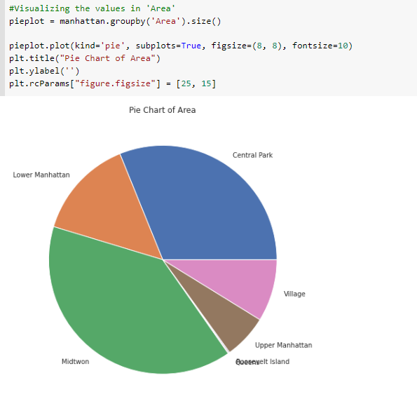
Data Wrangling 1/2
Handling with categorical features:
Grouping our 32 neighborhoods by 7 Areas
Grouping neighborhoods by 5 price levels
Create 3 type of targets (mean, mid and standard deviation)
Areas distribution example

Slide 9
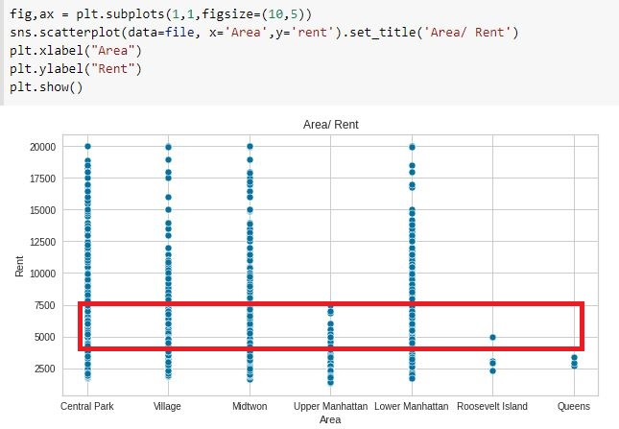
Data Wrangling 2/2
Using plot we can see the maximum rental price for all areas is about $ 5,000

Slide 10
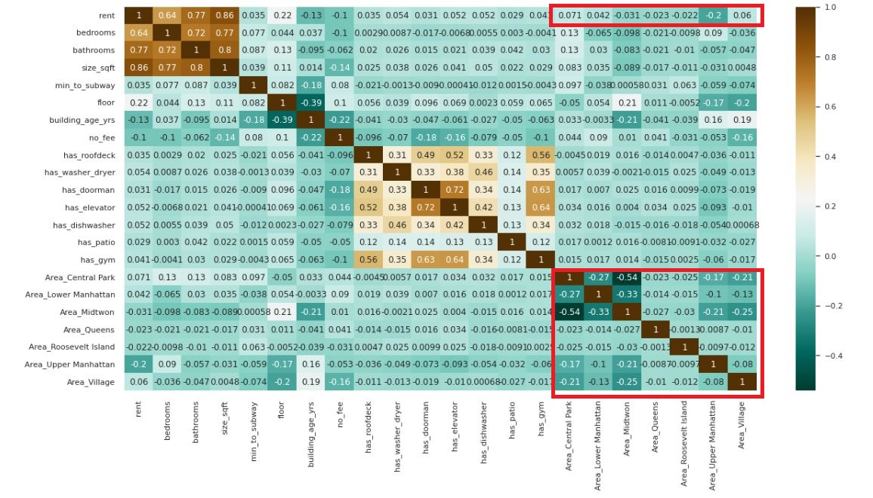
Correlation Matrix
Low correlation between areas to each other and areas to rent

Slide 11
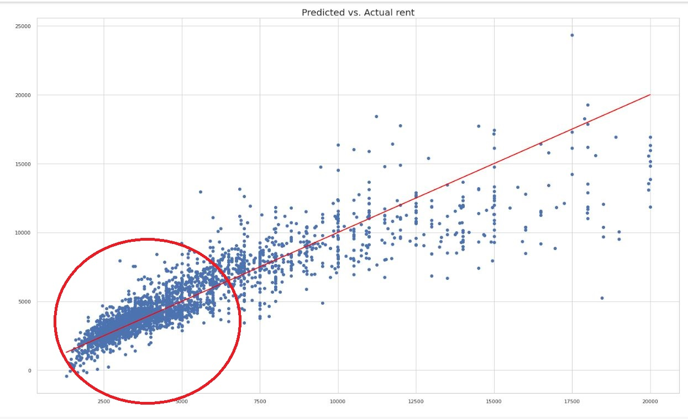



Regressions Model 1/4
Using model by areas group we can see that linear regression most relevant for rent prices up to $7000

Slide 12
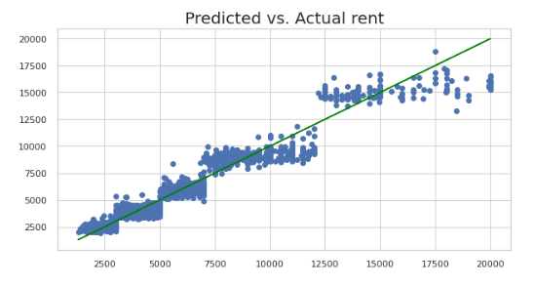



Regressions Model 2/4
Grouping by Prices

Slide 13
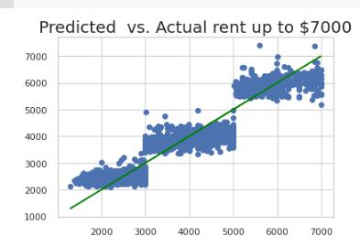



Regressions Model 3/4
Grouping by Prices up to $7000:
We can see decrease RMSE by different models

Slide 14
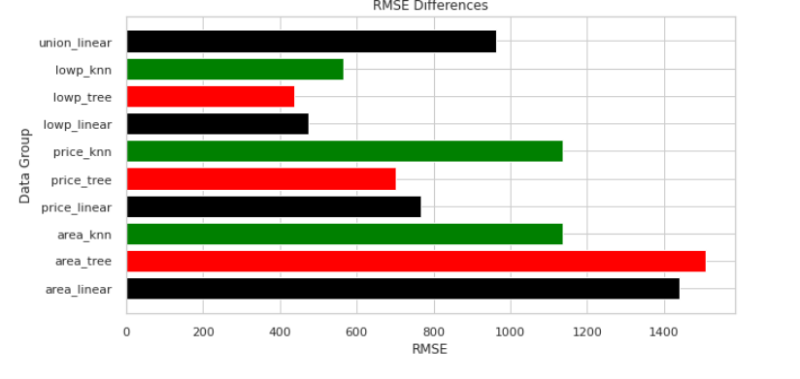

Regressions Model 4/4

Slide 15
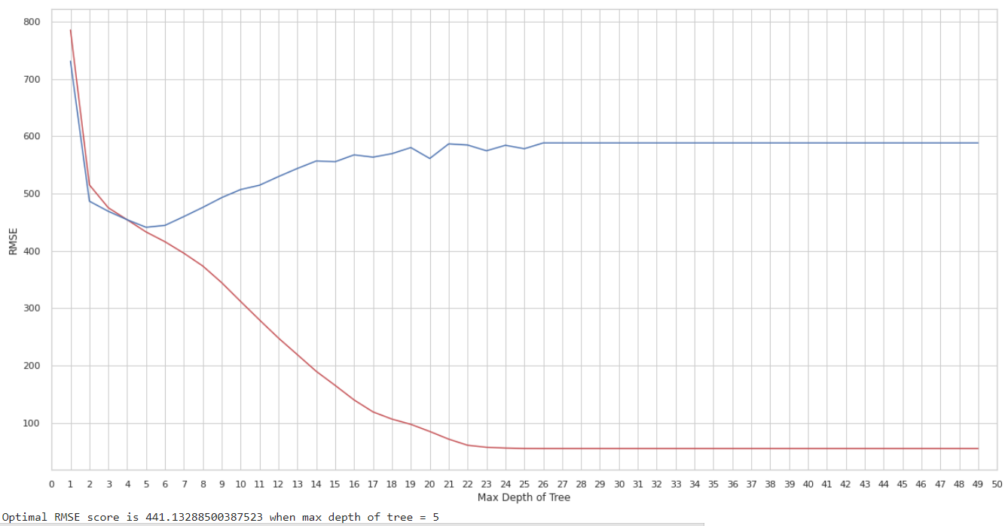
RMSE Scores with Decision Tree Regression

Slide 16
Conclusions and insights
Winner model was the Decision Tree with the price grouping and after limited the dataset up to $7000 rent price. Our accuracy is 87.8% on test data.
According to our dataset, up to 5k$ rent there is a high correlation between selected features [bedrooms, bathrooms, size, floor] to the rent price. Above that price the data is scattered and price determined by more particular features .
The areas feature we added by dividing Manhattan to parts , is not reflecting the rent prices as we were expected it to be
Future direction : Separate data set to at least 2 categories ; low-mid rent prices (which we did) and to mid-high prices . The mid-high prices should be analyzed separately and see which features will give the most accurate prediction.

